Slide 1

Marketing and Retail Analysis
Sai Komaravolu

Slide 2
Agenda
Problem statement
Data inferences
Data analysis
RFM analysis
RFM inferences

Slide 3
Problem statement
An automobile parts manufacturing company has collected data of transactions for 3 years. Provide customer with suitable insights about their data and their customers.

Slide 4
Data inferences
Dataset has 2747 rows and 20 columns, in that 12 columns are of Object type, 5 columns are of Integer type, 2 columns are of float type and 1 column is of Data type.
No nulls or duplicates are observed.
All numeric type columns follow a bell curve with no outlier values.
Summary: Dataset provided is clean, numeric features are normally distributed and no data transformation or imputation is required.
Assumptions: More than one record exists for same order number and a customer placed more than one order. Grouping by customer will yield in further understanding of the dataset.

Slide 5
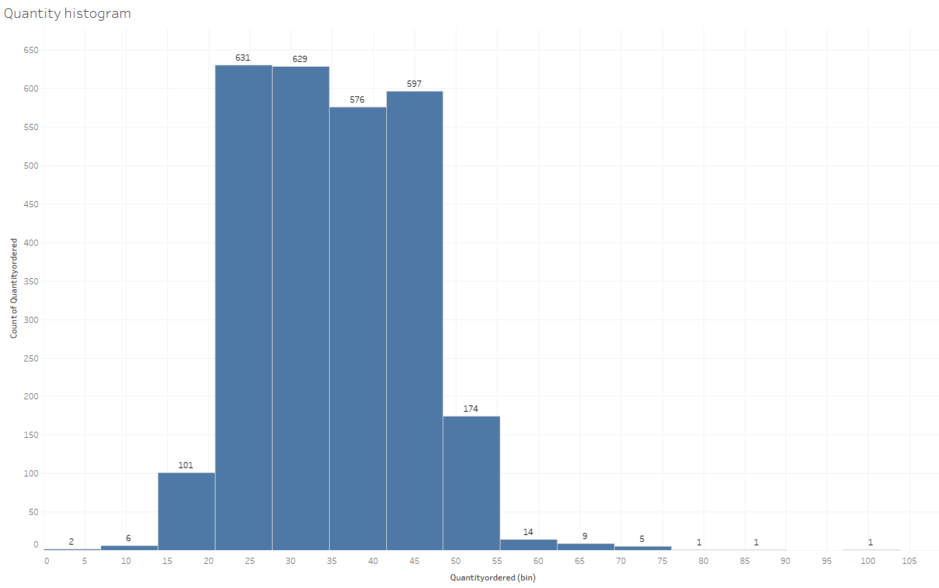
Data analysis – Uni Variate - Quantity

Slide 6
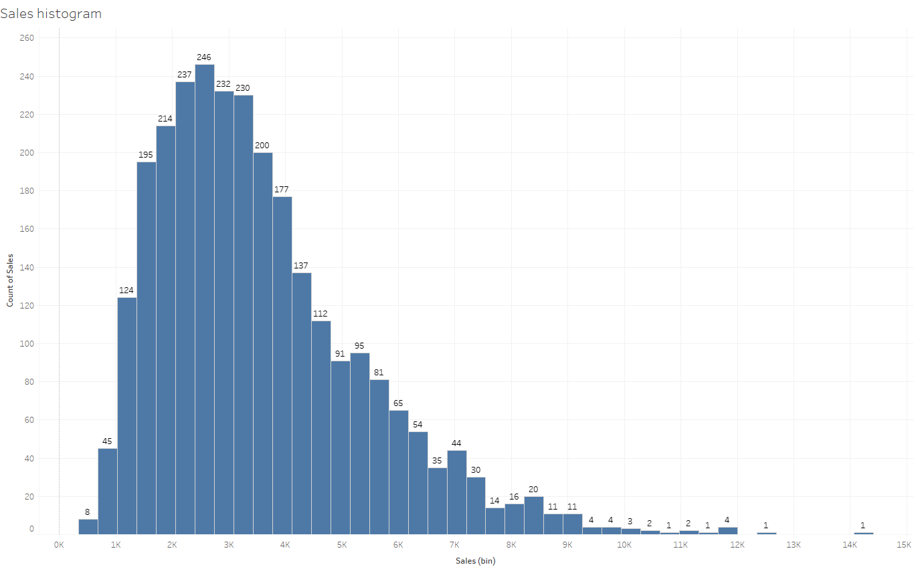
Data analysis – Uni Variate - Sales

Slide 7
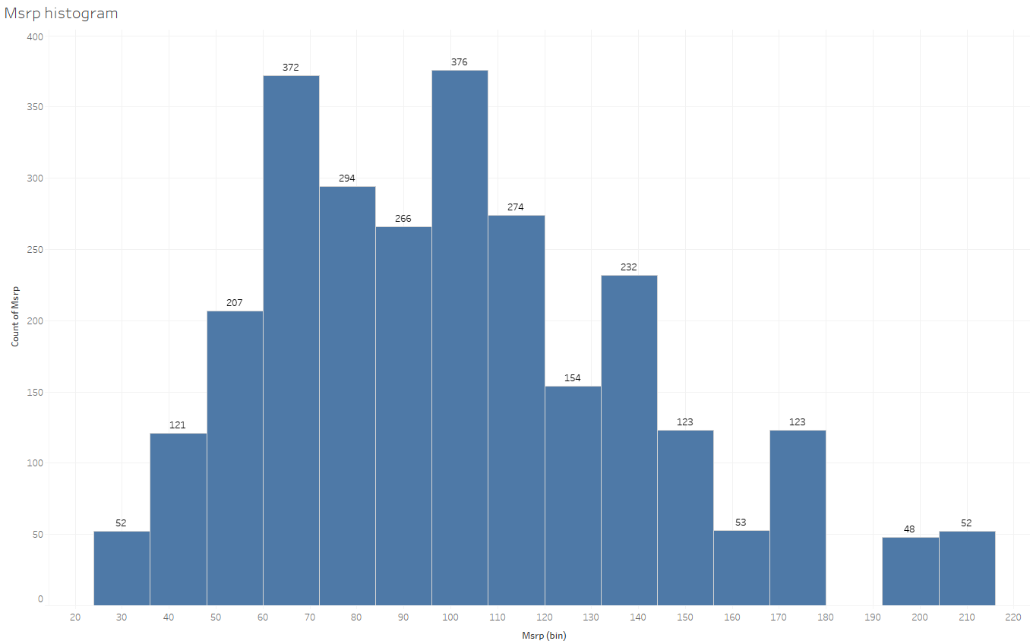
Data analysis – Uni Variate - Msrp

Slide 8
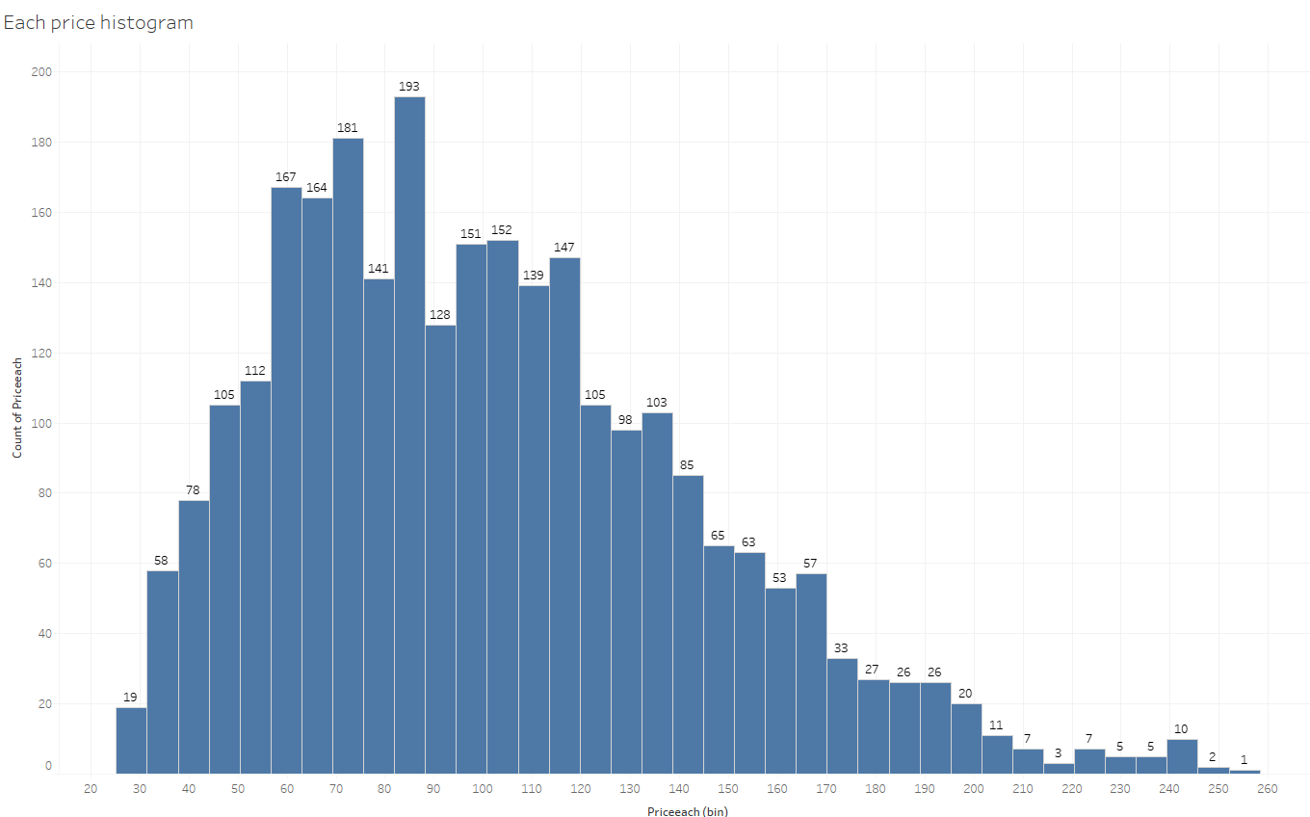
Data analysis – Uni Variate - EachPrice

Slide 9
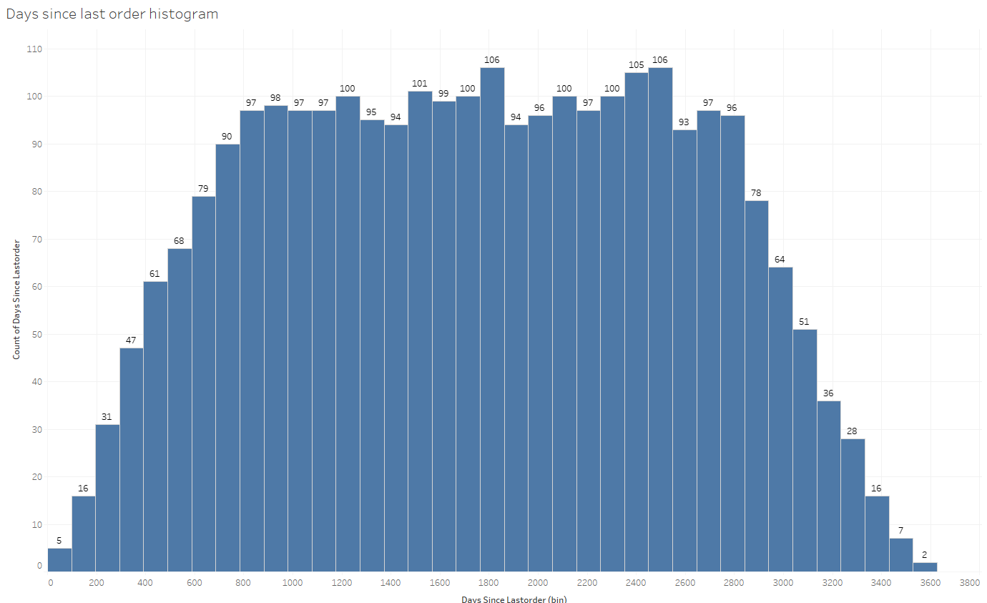
Data analysis – Uni Variate – Last Order Days

Slide 10
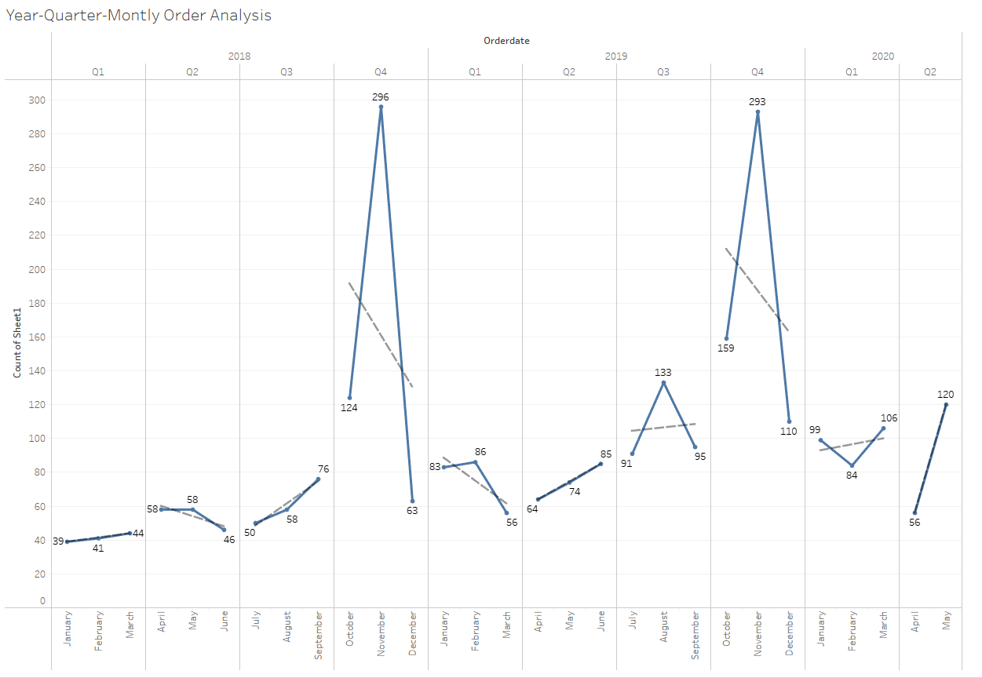
Data analysis – Year/Quarter/Month

Slide 11
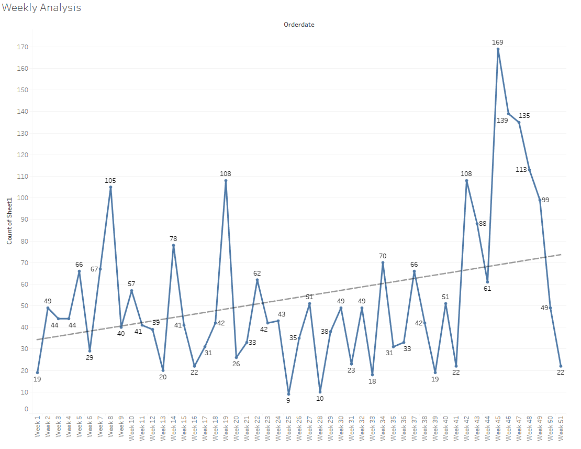
Data analysis – Weekly

Slide 12
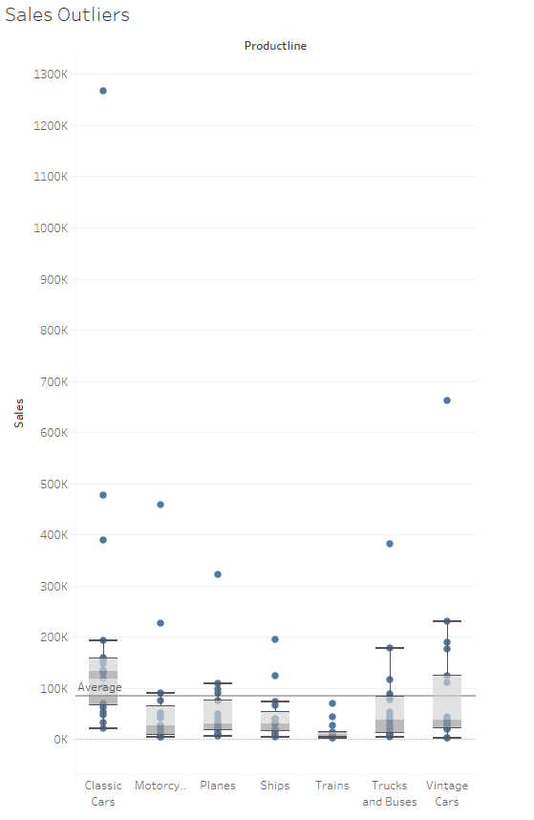
Data analysis – Sales Outliers

Slide 13
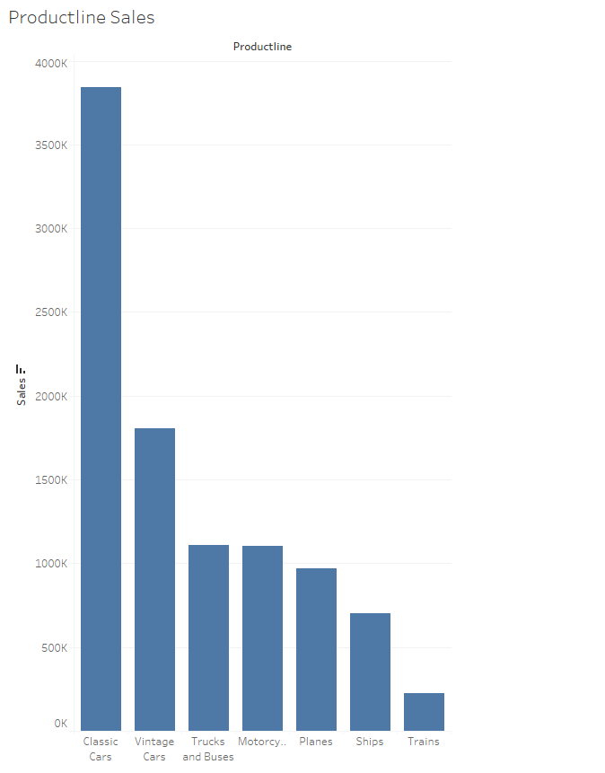
Data analysis – Bi Variate – Product vs Sales

Slide 14
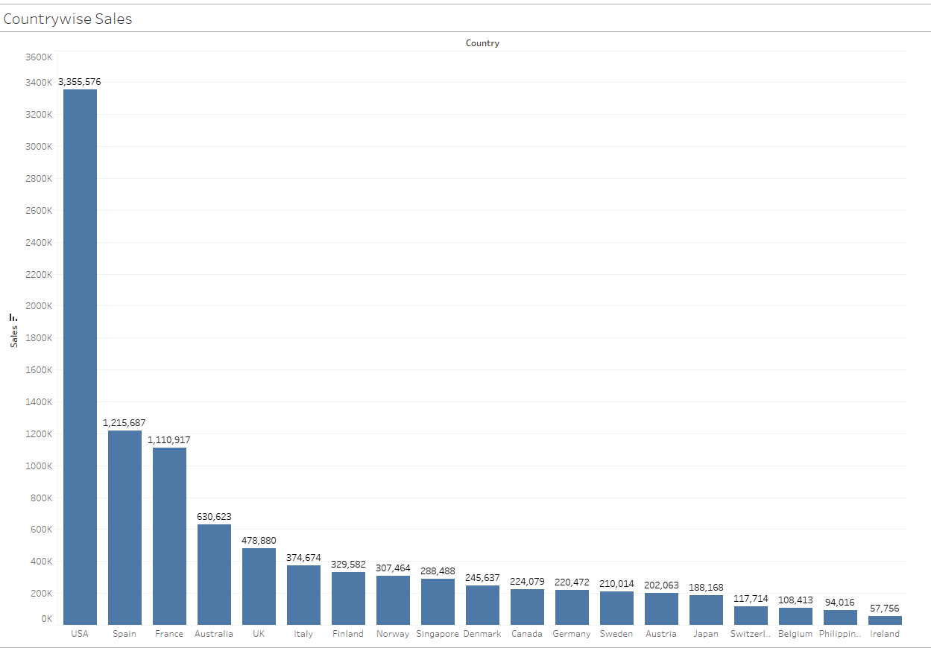
Data analysis – Bi Variate – Country vs Sales

Slide 15
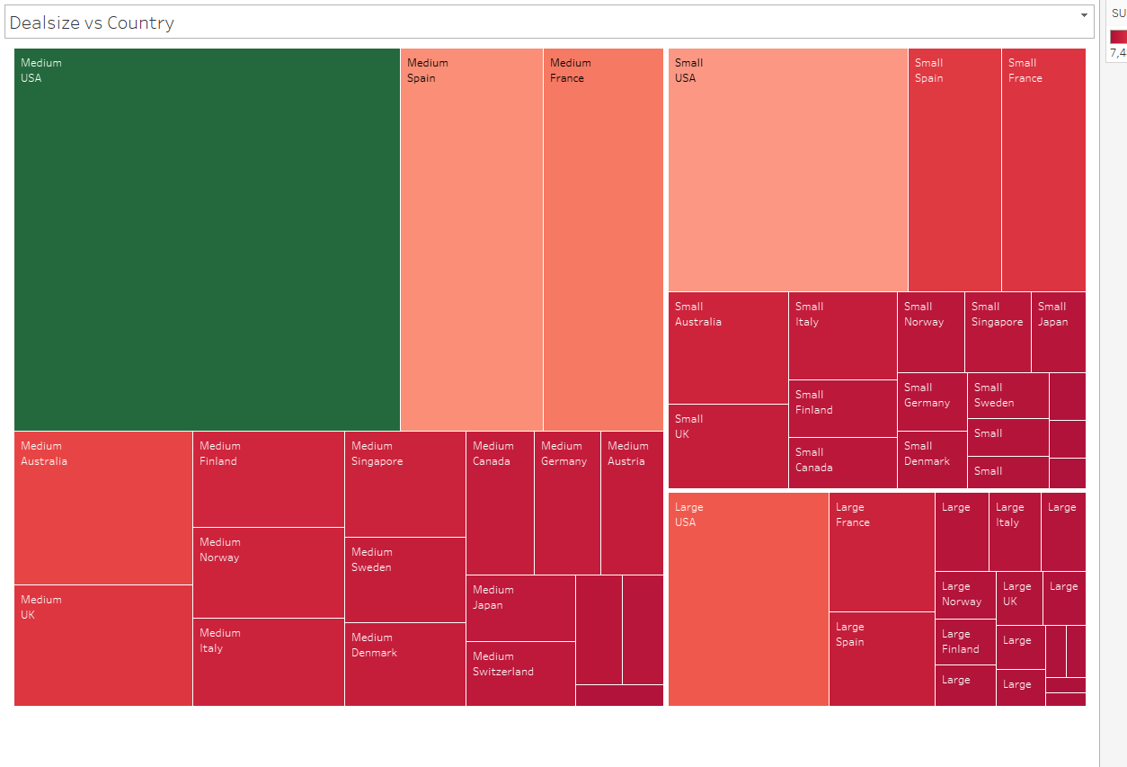
Data analysis – Bi Variate – Deal Size vs Country

Slide 16
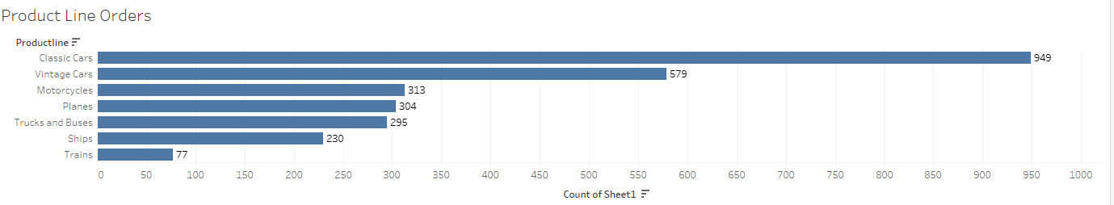
Data analysis – Bi Variate – Orders vs Product Line

Slide 17
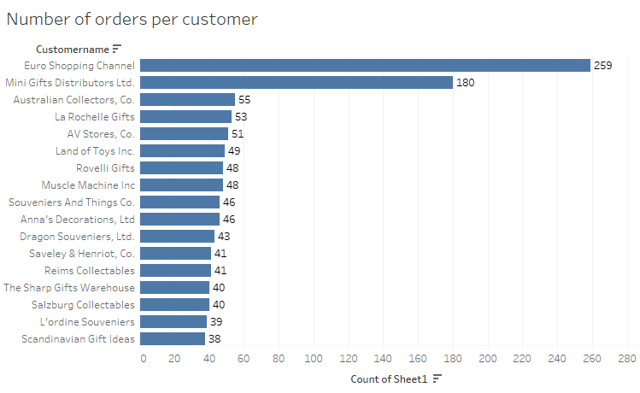
Data analysis – Bi Variate – Orders vs Customer

Slide 18
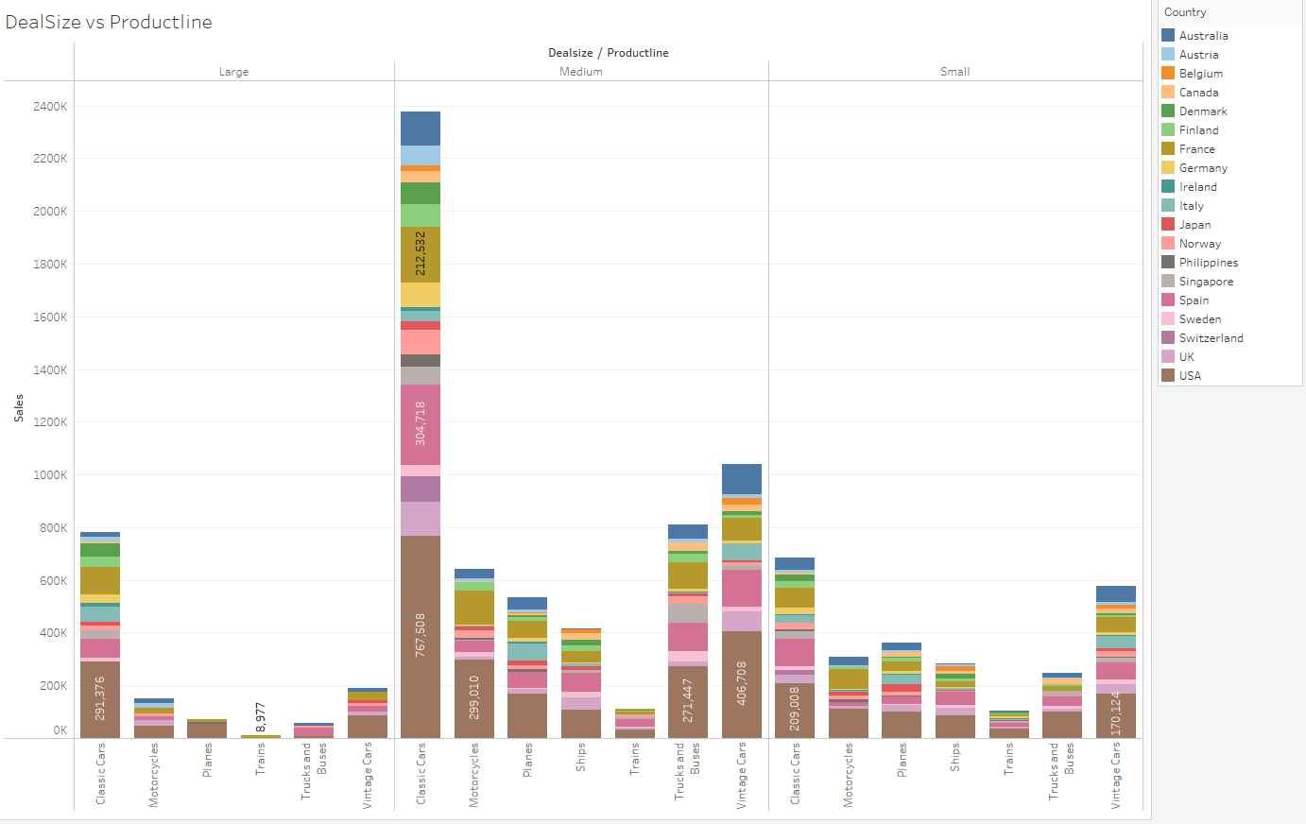
Data analysis – Multi Variate – Deal Size vs Product Line vs Sales

Slide 19
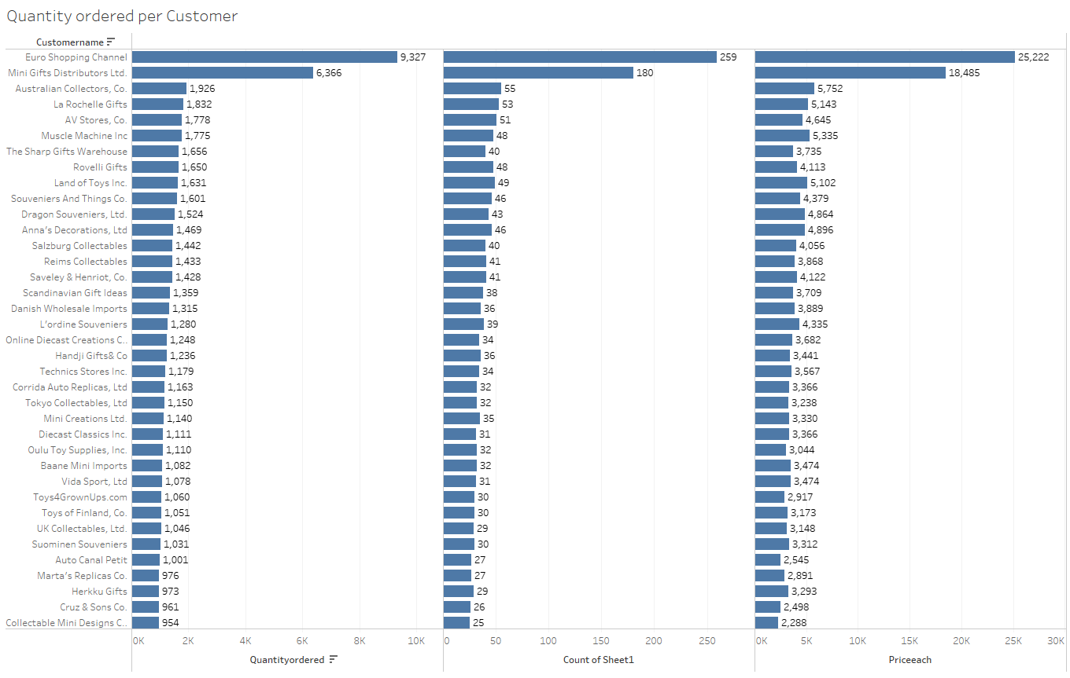
Data analysis – Multi Variate – Customer vs Quantity vs Orders

Slide 20
Uni, Bi and Multi Variate Analysis
Extreme sales were observed for classic cars product line, next to the line is Vintage cars.
Features; Quantity, Msrp, Last order days, are normally distributed.
Features; Sales and Each price are right skewed.
Classic cars product line has highest sales ever recorded in 3 years.
Trains product line has least sales for the recorded 3 years.
USA is highest player in Sales for all product lines.
Ireland is the least player in Sales for all product lines.
Medium deal size gets out maximum Sales for all product lines for USA.
“Euro Shopping Channel” customer has the highest orders at 259.
“Boards & Toys Co” customer has the least number of orders at 3.
“Euro Shopping Channel” customer has highest quantity ordered at 9327.
USA has highest orders count of 928 and Ireland least with 16.
Q4 sales were all time high for 2018 and 2019 years with an increasing trend.
In 2019 Sales increased to all time high in Q1 with a sudden decline at the end of Q2.

Slide 21
Customer Segmentation using RFM
KNIME is used for deriving RFM.
Customer name level grouping performed to derive Frequency.
Unit price * Quantity to derive Monetary.
Data and time difference between date ordered and today to derive Recency.
Auto binner to bin the RFM metrics.
Cell replacer will assign Low, Medium and High to RFM values.

Slide 22
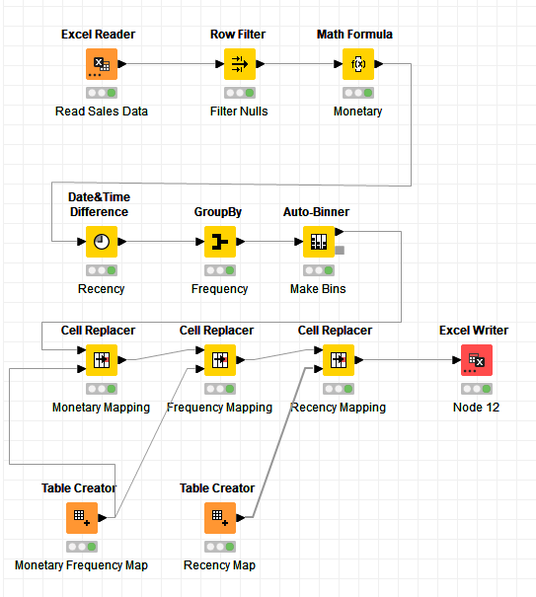
Customer Segmentation using RFM – KNIME workflow

Slide 23
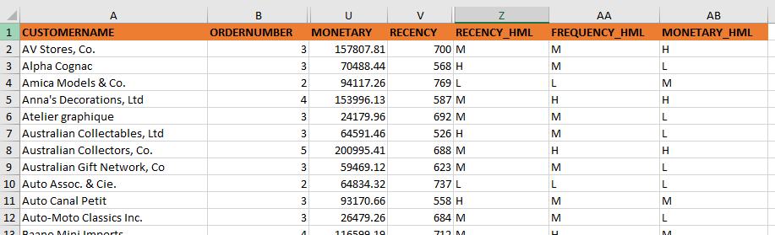
Customer Segmentation using RFM – Output table head

Slide 24
Customer Segmentation using RFM – Inferences
Best customers:
Verge of churn:
Lost customers:
Customer | Monetary ($)
Euro Shopping Channel | 912294.11
Mini Gifts Distributors Ltd. | 654858.06
La Rochelle Gifts | 180124.9
The Sharp Gifts Warehouse | 160010.27
Souveniers And Things Co. | 151570.98
Customer | Monetary ($)
Australian Collectors, Co. | 200995.41
Muscle Machine Inc | 197736.94
Dragon Souveniers, Ltd. | 172989.68
Land of Toys Inc. | 164069.44
Anna's Decorations, Ltd | 153996.13
Customer | Monetary ($)
CAF Imports | 49642.05
West Coast Collectables Co. | 46084.64
Cambridge Collectables Co. | 36163.62
Double Decker Gift Stores, Ltd | 36019.04
Bavarian Collectables Imports, Co. | 34993.92

Slide 25
Customer Segmentation using RFM – Inferences
Loyal customers
Customer | Monetary ($)
Euro Shopping Channel | 912294.11
Mini Gifts Distributors Ltd. | 654858.06
La Rochelle Gifts | 180124.9
The Sharp Gifts Warehouse | 160010.27
Souveniers And Things Co. | 151570.98

Slide 26
Customer Segmentation using RFM – Summary
“Euro shopping channel” is a Loyal and Best customer with high monetary value.
“Australian Collectors Co” is on the verge to breakup, organization should provide offers on frequent visits.
“Bavarian Collectables Imports Co” is a lost customer, organization shall not spend any funds is advised.

